Slide 1
Phone Pricing Models (Data Set 1)

Slide 2
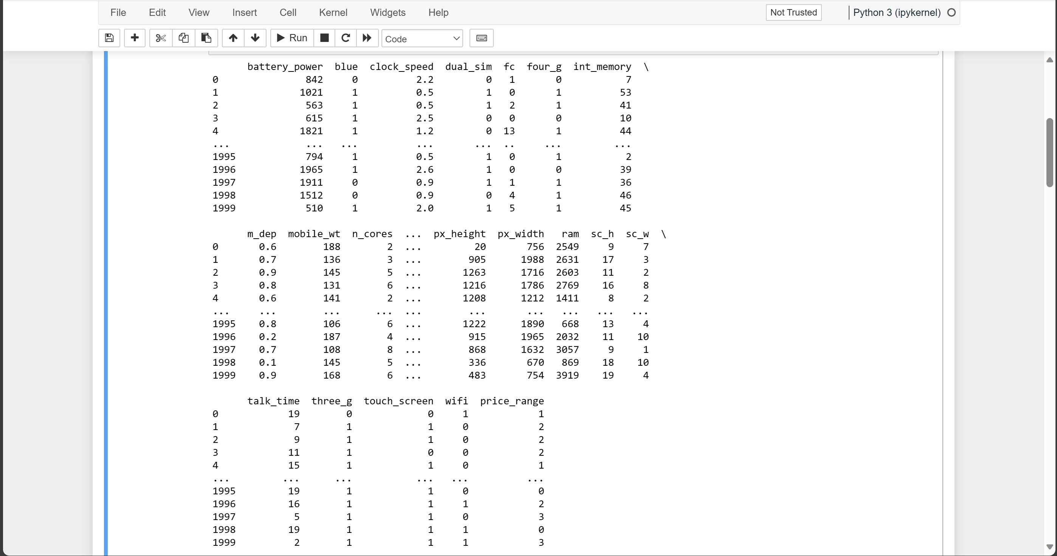

Slide 3
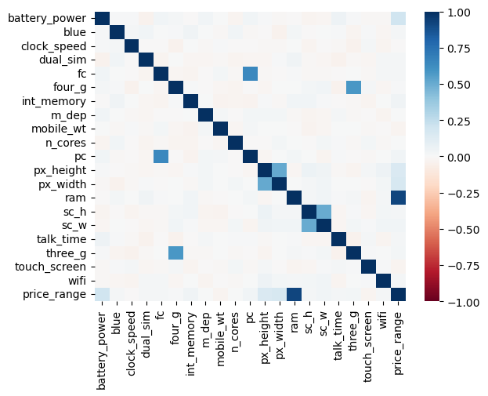
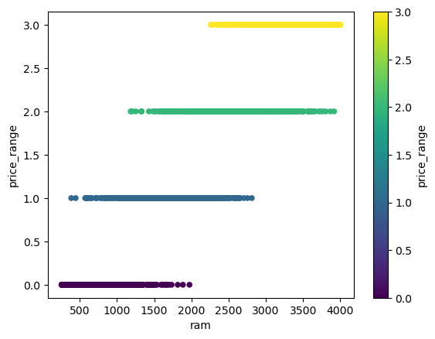
Data Visualization

Slide 4
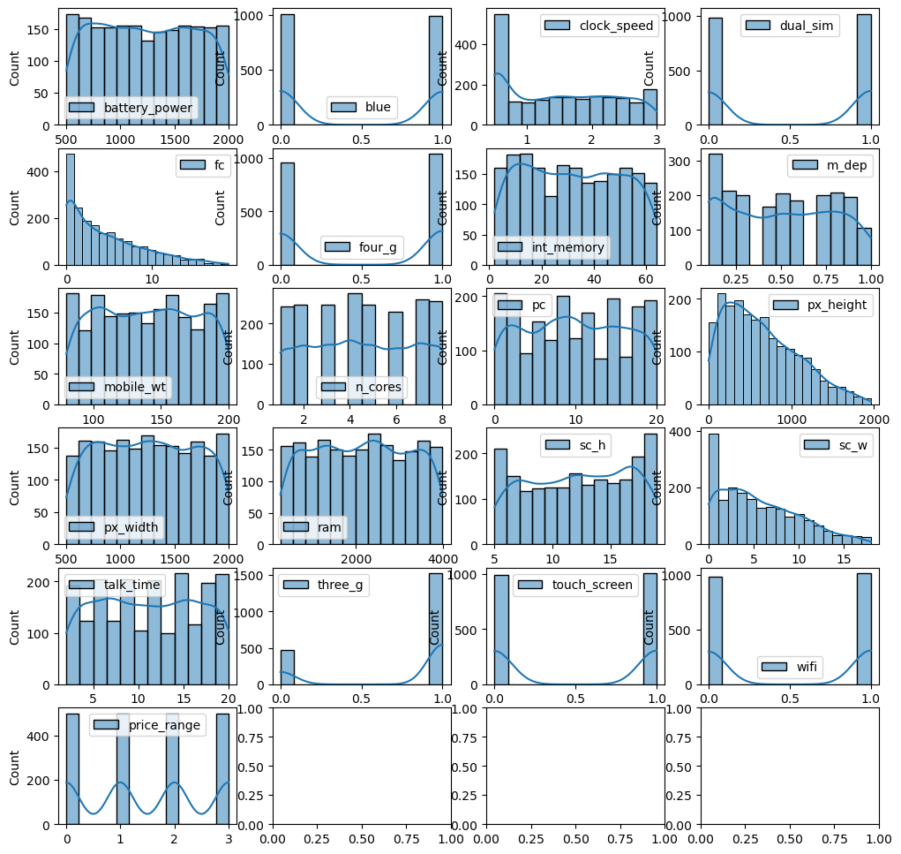

Slide 5
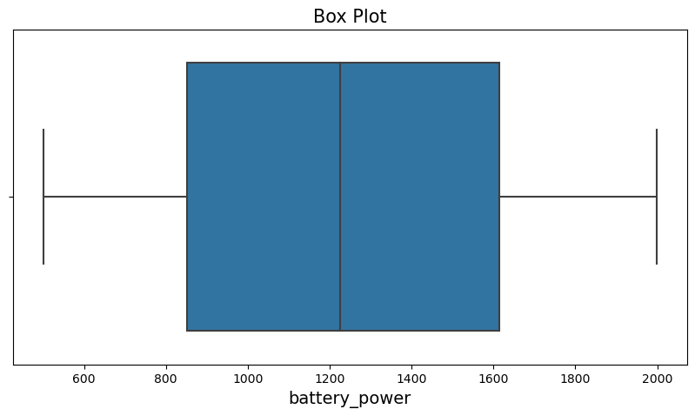
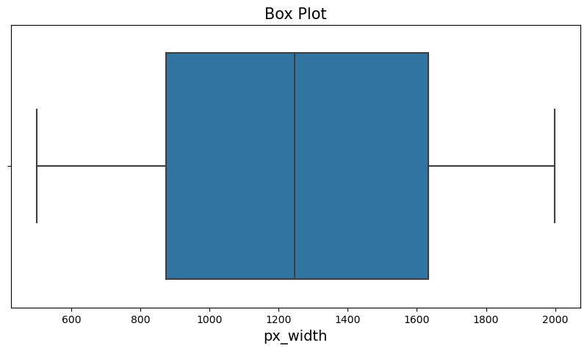
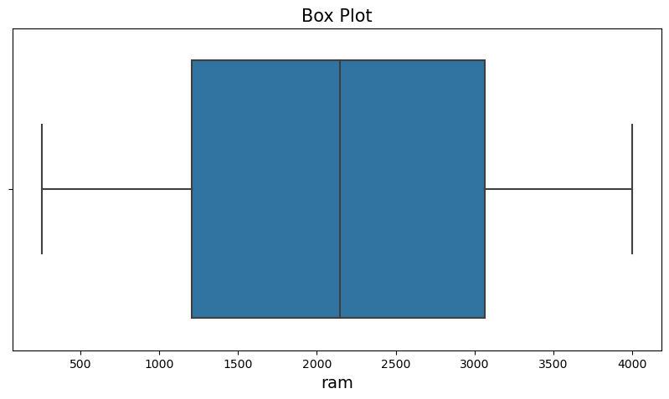
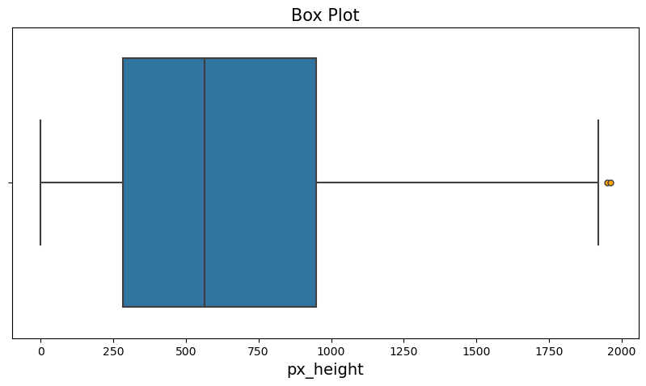

Slide 6
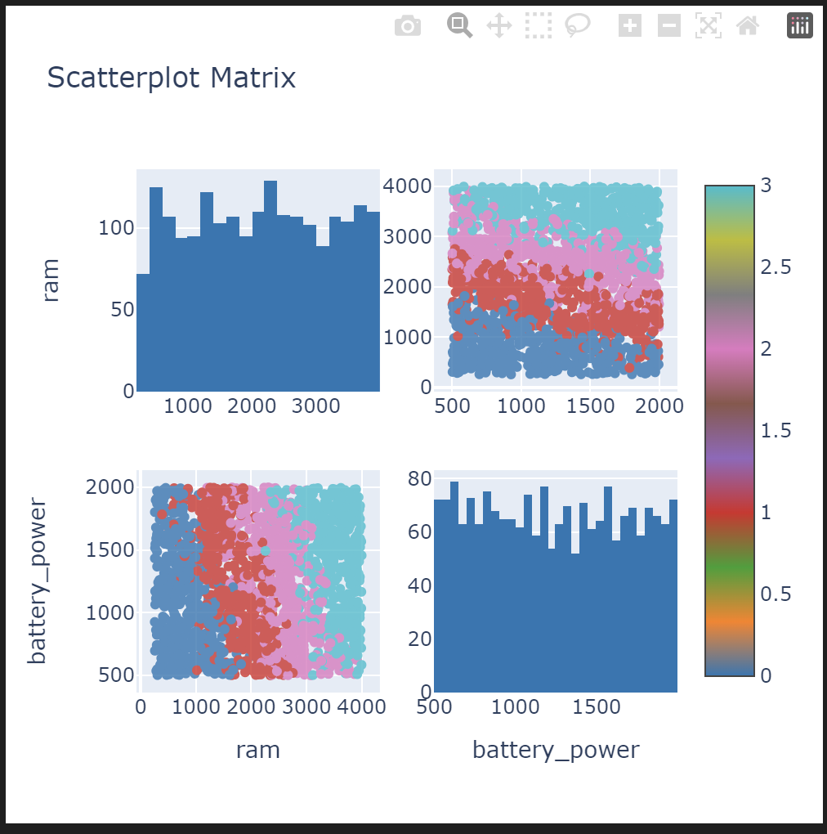
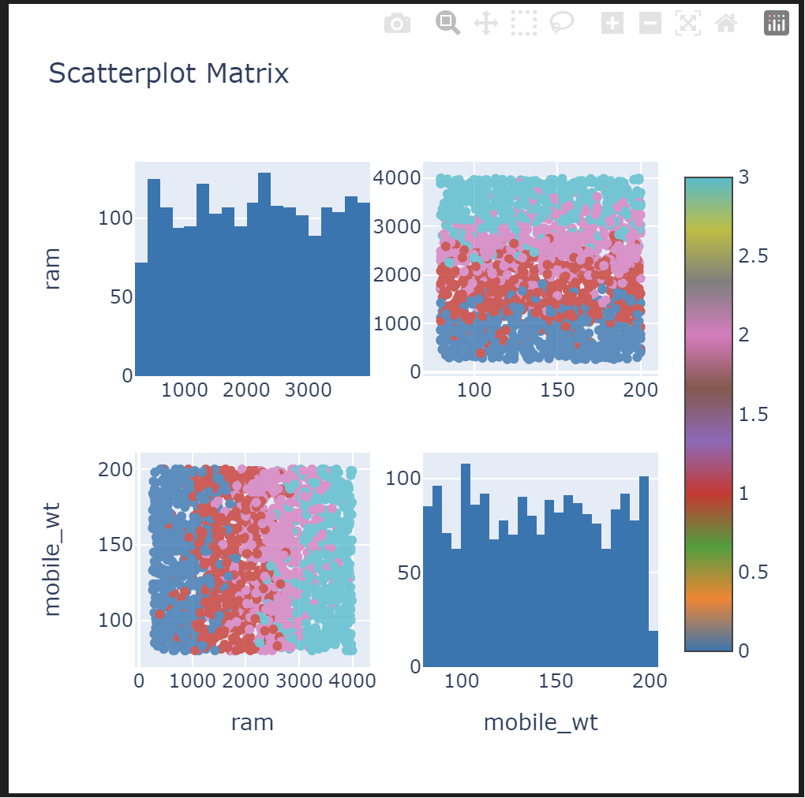

Slide 7
Likely forms of classification
SVM – Support Vector Machines
Takes the distances between a line (made by a linear combination of weights and inputs) and the closest points of each class and adjusts the weights to maximize each distance.
In doing so, it creates a line that separates two classes
ANN – Artificial Neural Network
We could use a one hot decoder along with an artificial neural network to create 4 outputs (one for each price range value) as binary values.

Slide 8
Issues moving forward
The data isn’t completely separable by any type of line (you can see some red dots contained inside the cluster of red dots).
Maybe treat them as outliers?
Not sure if ANN can account for overlap of classes. Might lead to higher error.

